Slide 1

Data Techniques for Engineers and Scientists
J.D. Landgrebe
Dept. of Chemical Engineering, University of Delaware
Data Delve Engineer LLC

Slide 2
Agenda: Data Techniques for Analysis and Modeling
What’s a healthy basis for selecting and using software as an engineer or scientist?
“Generalist” engineer/scientist software recommendations
Using “Use Case” concept to create clarity talking about software
Review Intro to JMP® software for exploratory data analysis, stats and visualization
A roadmap for experimental data
A good nomenclature and block diagram for data transformation
Using JMP® to transform data for analysis
Using Python and Python libraries in a practical way
Anaconda for Python library management
“Tuhdoop” (aka TDD/OOP) approach for organizing bigger, Python projects
Using Python/Pandas to transform experiment data for analysis
Parsing instrument-generated data – Example, reapplicable Python script
JMP Regression Exercise/In-Class Assignment: Cooling of Solid Consumer Products
[Bonus Topic 1] Using engineering (and common sense) principles to linearize experimental data
[Bonus Topic 2 Fitting models to consumer rating data
version: November 21, 2023

Slide 3
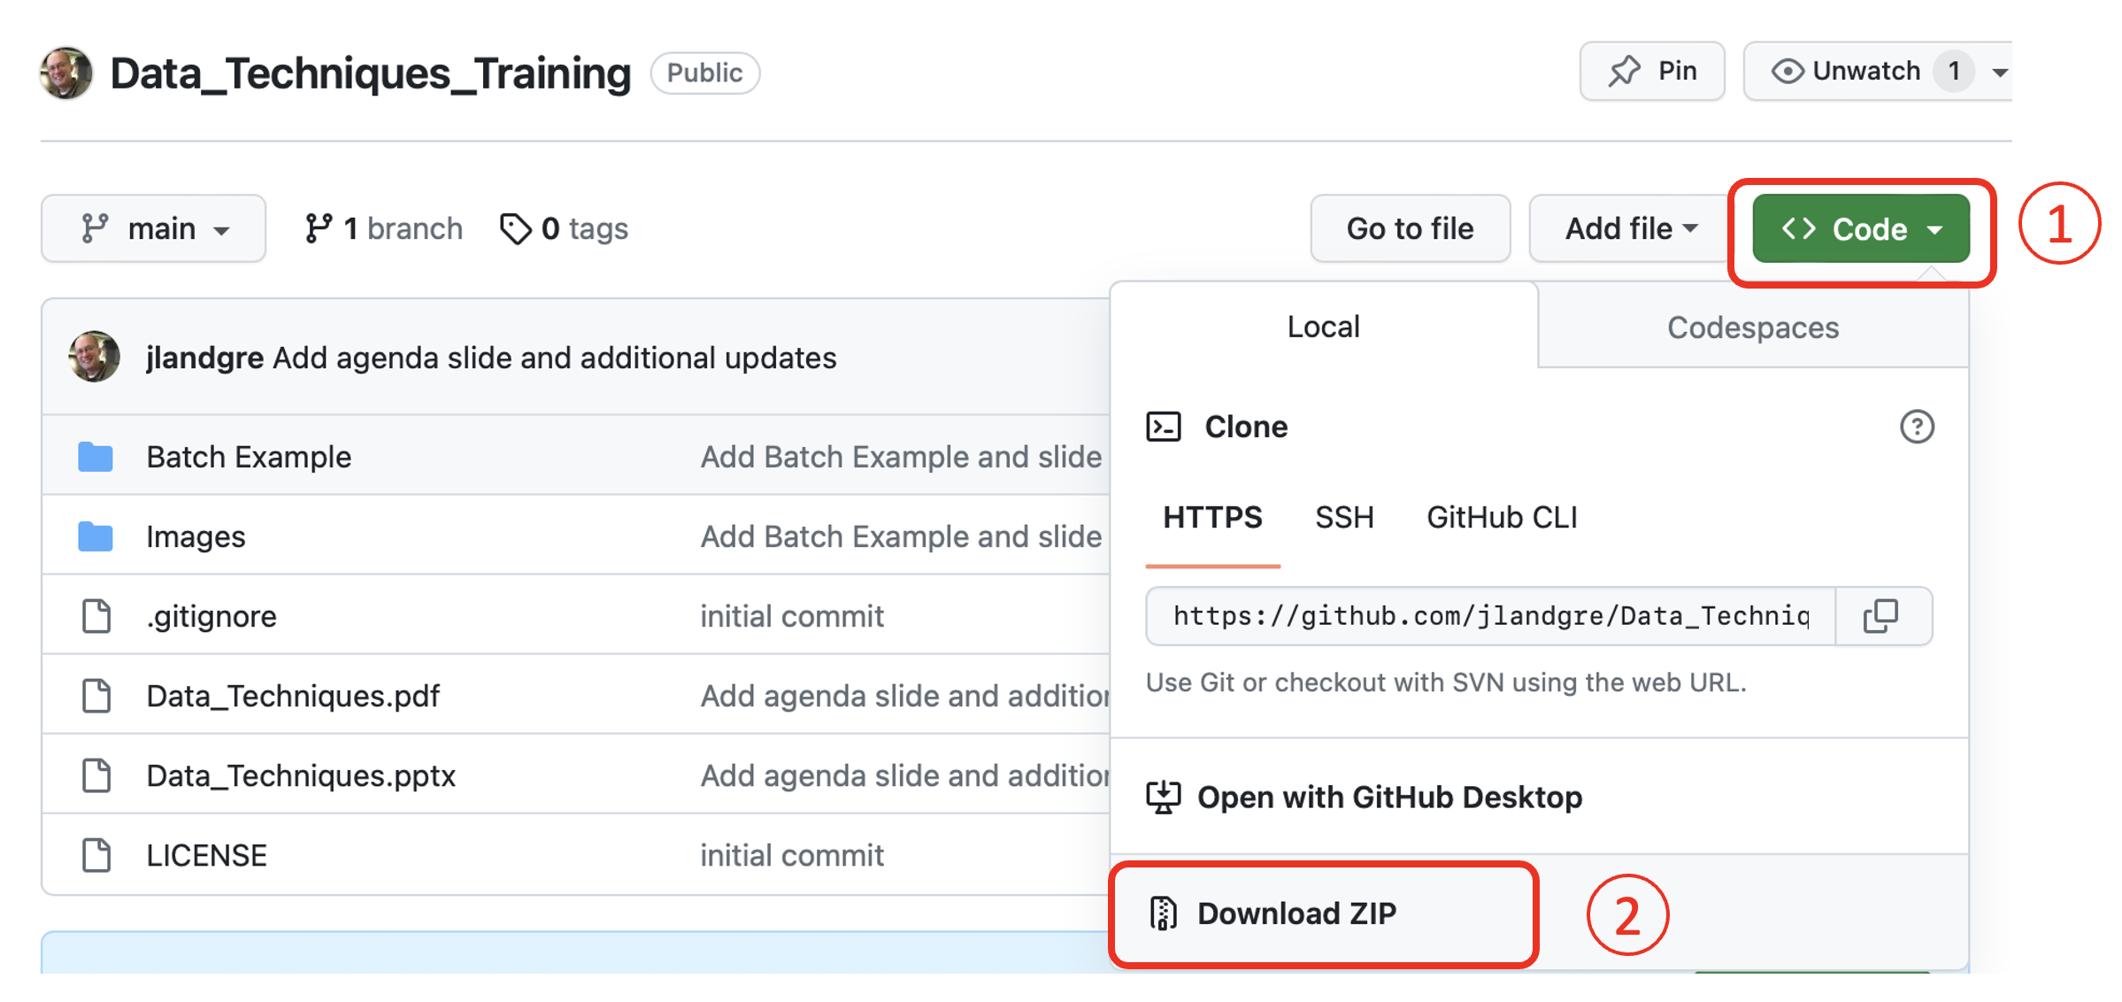
Downloading Tutorial Files
Download these notes and case study files from Github repository: https://github.com/jlandgre/Data_Techniques_Training
Github: Good for engineers to know! It’s common for sharing open-source materials like this tutorial
Github repositories can be open (like this one) or private

Slide 4

Software for Engineers
Pick software by “use case” and use each software in its “lane” where it is best tool for the job
“Use cases” is a useful way of compartmentalizing tasks or activities in software
Use cases start with “I need to…” (or “my customer needs to…”)
My supervisor needs to be able to scroll through our raw data to understand the results
I need to create a correlation matrix for my raw material’s quality data
I need to build a validated calculation model for reaction kinetics
Use case focus
Avoids getting (yourself and others) distracted by things that software X is not good at – there is no perfect software tool
Puts a premium on making data portable across applications

Slide 5

Generalist Engineer/Scientist Software Recos by Use Case
JMP® software - design of experiments (DOE), exploratory analysis and data visualization with accompanying statistical analysis
Microsoft Excel® - make data usable by others, generate “end of the pipeline” reports and create spreadsheet models with calculations for use by yourself or non-coders
Python scripts for data reshaping and for developing coded models and data pipelines (possibly mixing in a little SQL)
https://datadelveengineer.com/the-right-modeling-and-analysis-tools-for-the-job/

Slide 6

Additional Software Recommendations (Engineers are Coders!!)
Python scripting tools - build model and data cleaning scripts
JupyterLab (via installation of Anaconda distribution)
VS Code script and text editor (https://code.visualstudio.com)
Github Copilot and Chat extensions VS Code ($$)
VBA Scripting Language – Excel automation
Advanced visualizations – Python Matplotlib
Github - Open sharing of projects, trainings etc.

Slide 7
JMP® Intro
We completed this intro as prework. Any questions from the tutorial and confirmatory assignment?
Goals of Intro are for you to get software installed and explore its basics
Reminder of JMP Intro links:
Introductory video: https://vimeo.com/manage/videos/863637866
Tutorial: https://github.com/jlandgre/JMP_Intro_Tutorial
Confirmatory assignment file in tutorial folder: JMP Preassignment.pdf

Slide 8

Objectives Working with Experiment Data
Experiments* have a common data structure (we will call it “architecture”).
Recognizing this lets us master common data techniques to analyze efficiently and have data in good formats for graphing
Objectives
Learn reusable terms for the data elements from experiments
Learn how use software to do needed transformations to go from raw data to analyzed summary
Learn how to “curate” experimental data to make it easy to find and share
* Data don’t know whether they were generated in a lab or virtual experiment, so this applies to computer modeling data in addition to physical experiments

Slide 9
What are Experiments?
Experiments Cover An amazing range for engineers and scientists!
Make a production or lab-scale batch of several product formulations
Run a packing line using pre-set conditions for a set amount of time
Crash a sensor-equipped car into a wall
Diaper a baby with several product designs
Drive a F1 car around a track with several various fuel mixtures
Ask a man to shave his face with 3 different types of razors on consecutive days
Make batches of cookies with different types of chocolate
Wash test, fabric swatches with different detergent formulations
Use different catalysts to run a chemical conversion with the same starting materials
Use PCR to replicate and sequence the DNA from multiple virus samples
Mop floors with mops using different cleaning solutions
Surgically implant artificial joints manufactured with different polymeric coatings

Slide 10

What Do these have in common?
Experiments (or ”studies”…we will use synonymously) are a building block for designing and confirming products.
Experiments have “runs” consisting of one or more conditions having controlled inputs such as the starting materials and test conditions
A run can be described by a list of the “run variable” values which are the pre-set inputs and important ambient conditions recorded during the run.
Experiments generate “raw data” consisting of the original measurements to assess what happened (detailed speed versus time data for F1 car circuit around a track)
The raw data gets converted to “parameterized data” which is quantities reflecting the outcome (average speed for a complete track circuit)
Run variable values can be assembled into a “run matrix” with a single row of values for each run

Slide 11

Why does Standard Study Nomenclature matter?
Reusable ”lens” that you can use in any context
Knowing nomenclature and architecture gives you a “seeing eye” for how to plan and organize experiments
Identifies efficient, generic ways of converting the Run Matrix and Raw Data into analyzed data and conclusions
Parsers to convert raw data to structured tables
“Join” and “Concatenate” to bring data together into a “Master Study File”

Slide 12
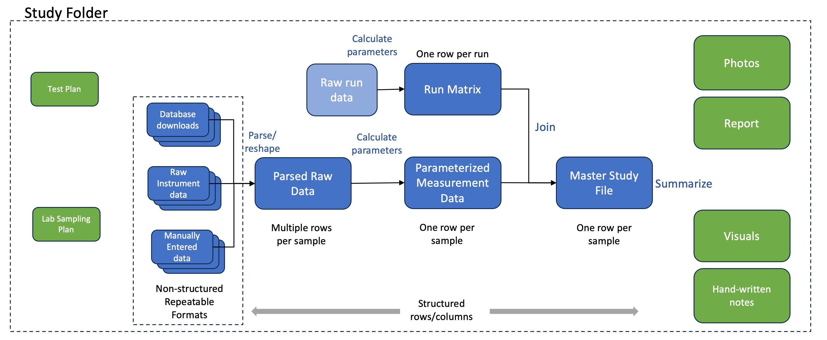
Experiment Data “Architecture”

Slide 13
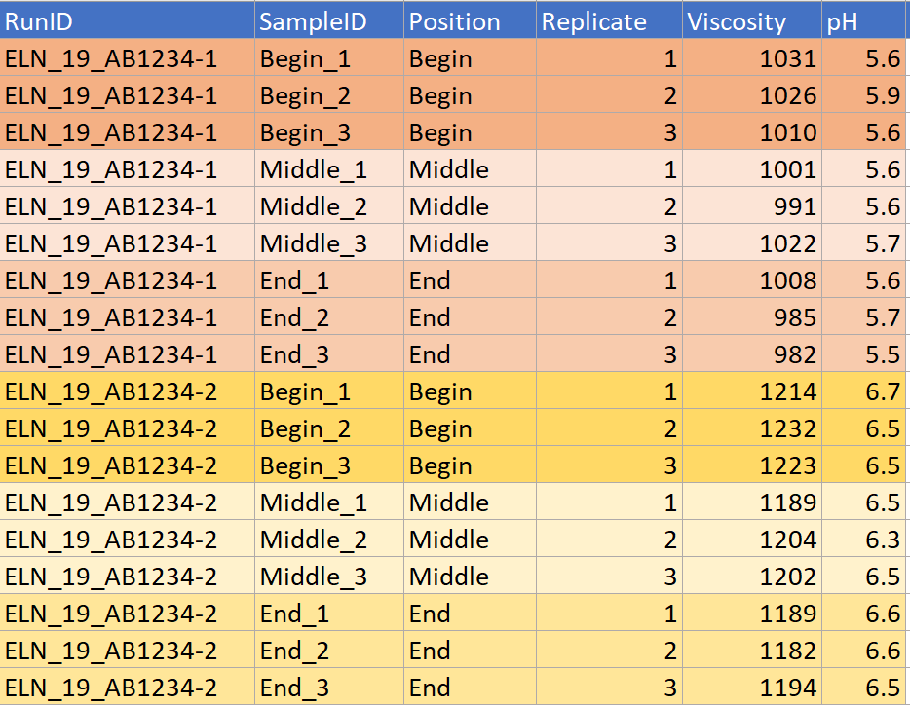
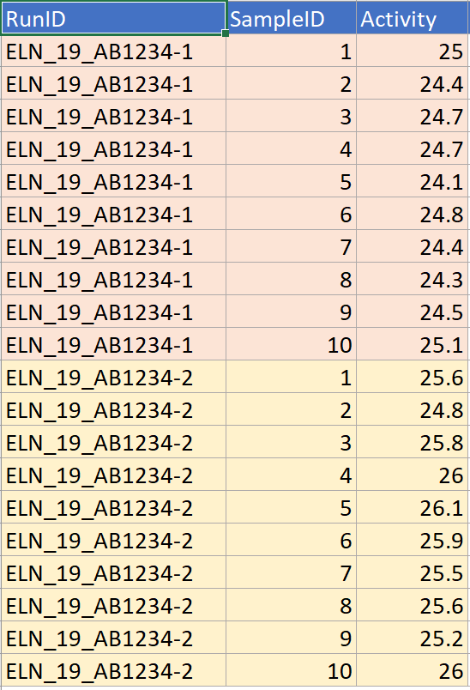
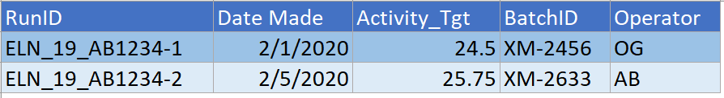
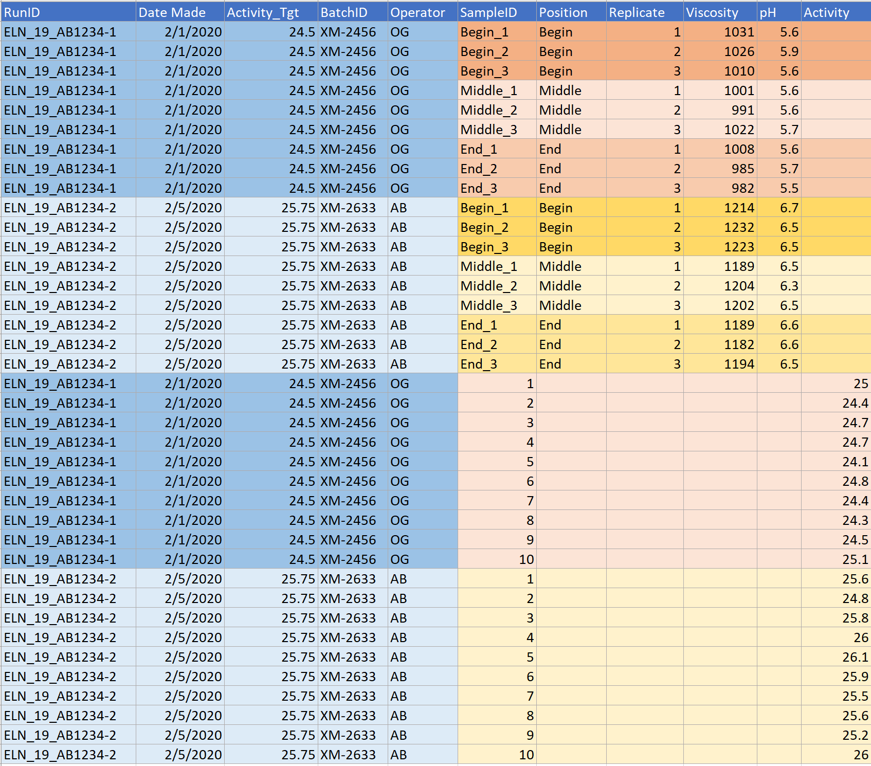
Creating A “Master Study File” to Summarize an Experimental Study
Measurement Data 2
Measurement Data 1
Experiment has two Runs that vary Activity_Tgt
Once raw data are parsed into rows/columns, we can join data and the run matrix to analyze the study
Example study data has two measurement files and Run Matrix
ELN_19_AB1234 Measurements_Activity.csv
ELN_19_AB1234 Measurements_pH and Viscosity.csv
ELN_19_AB1234 Run Matrix.csv
Goal is analyze by Run Matrix variables
Need to also check within-run variability
Run Matrix
Concatenate + Join
(in JMP or Pandas)
Master Study File

Slide 14
Experimental Data “Keys”
Sample ID – Uniquely identifies “when/where” tested material came from
Run ID – Uniquely ID’s composition and conditions
aka Batch ID, Laundry Load ID, Panelist ID, Modeling Run ID
Analyte Name
Keys [aka data nametags] make data easy to summarize and traceable
A measurement data point needs up to 6 keys to fully identify the measurement and its source
Avoid generic Run ID’s (e.g. “Run 1”) because makes difficult to combine studies
Check: Is each row identified by unique keys?
Study ID – Uniquely ID’s collection of Runs; Use ELN Experiment number or created date string as StudyID
Other Keys Needed
AnalysisID – Uniquely ID’s an instance of analyzing Samples from a Run (Lab software often assigns this)
PositionID – Identifies order of data points in curve data

Slide 15
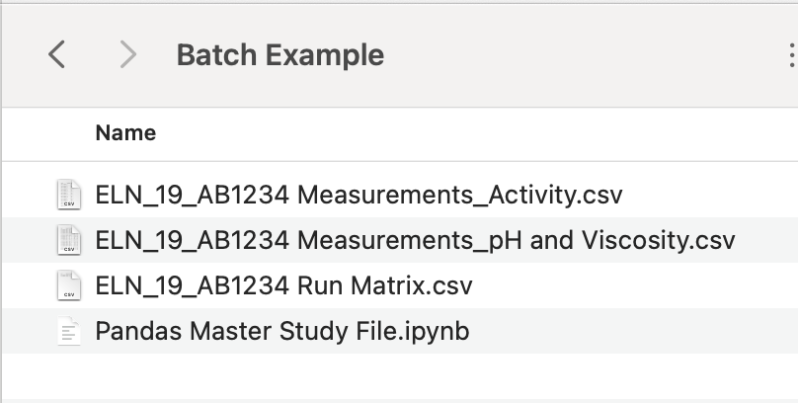
Exercise: Assemble Master Study File
Open the Batch Example files and manually copy/paste to arrange like the Master Study File on previous slide
Copy/paste to put the two sets of measurement data one on top of the other –inserting blank columns as needed for Activity data
Copy paste the appropriate Run Matrix row in blank columns to left of the data
Clean up by deleting one of the two RunID columns
Use JMP to do the same thing (See instructions on following slides)
Open Jupyter notebook Pandas Master Study File.ipynb and use it to create the Master Study File

Slide 16
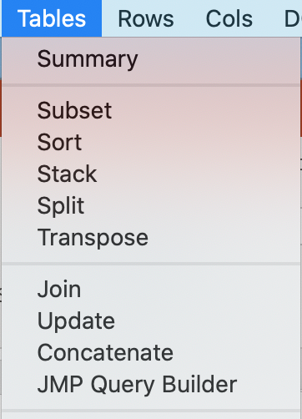
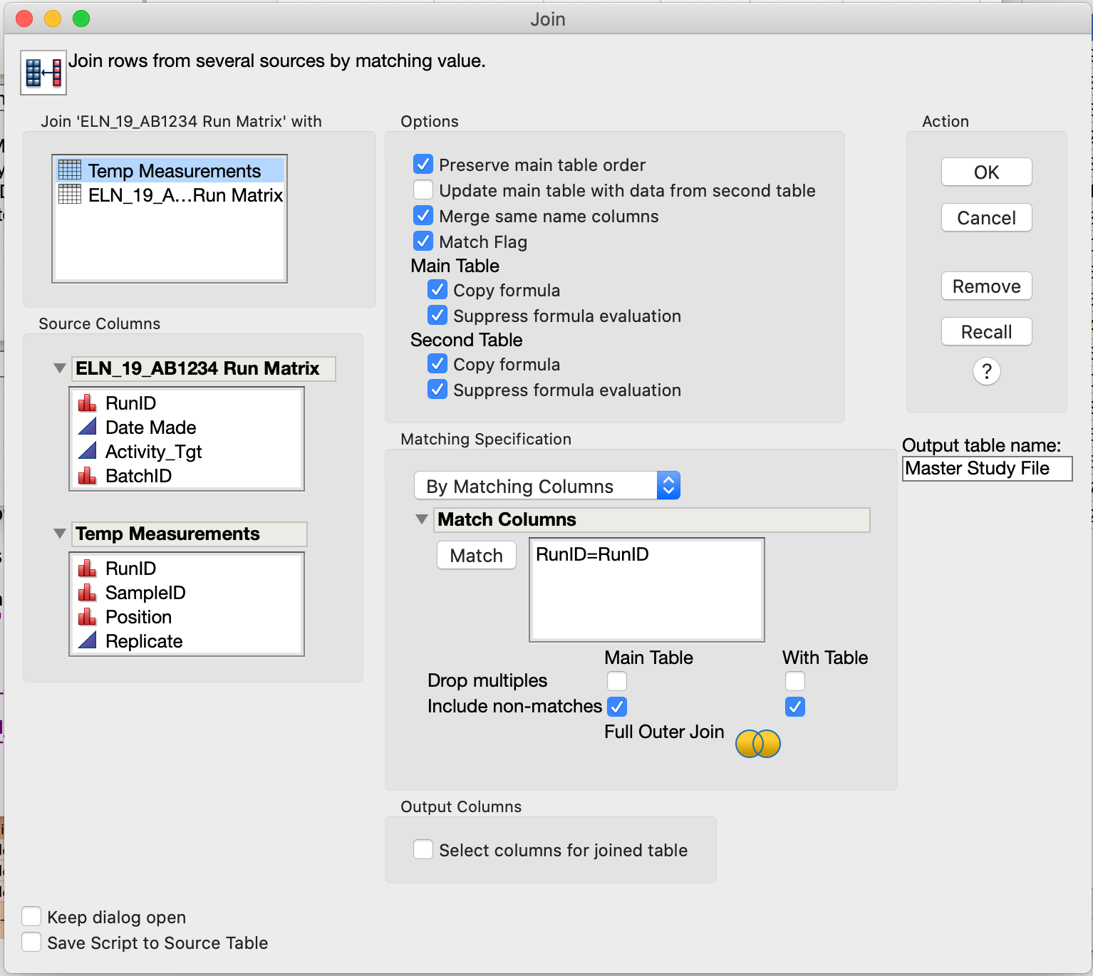
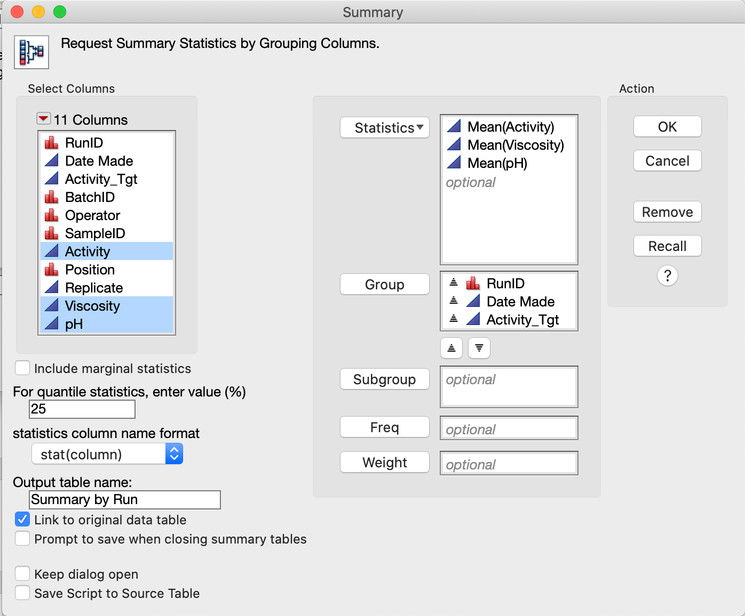
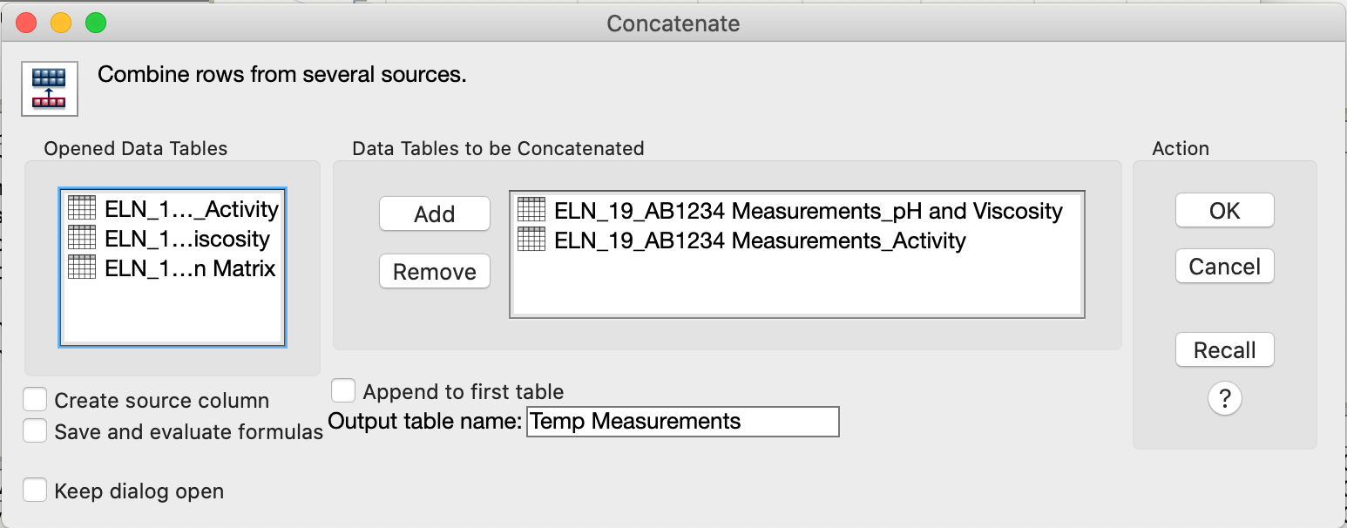
Aggregating and Summarizing Data (JMP)
Open JMP and three *.csv files in Batch Example sub-folder
To get Master Study File and Summary
Tables/Concatenate: Measurements_Activity.csv and Measurements_pH and Viscosity.csv (Makes Temp Measurements.csv)
Tables/Join: Run Matrix.csv and Temp Measurements.csv
Tables/Summary
Use Master Study File for statistical analysis
Join Run Matrix with measurements
Summarize by Run
Concatenate measurements
7
1
4
1
5
1
3
2
2
6
2
3
4
3

Slide 17
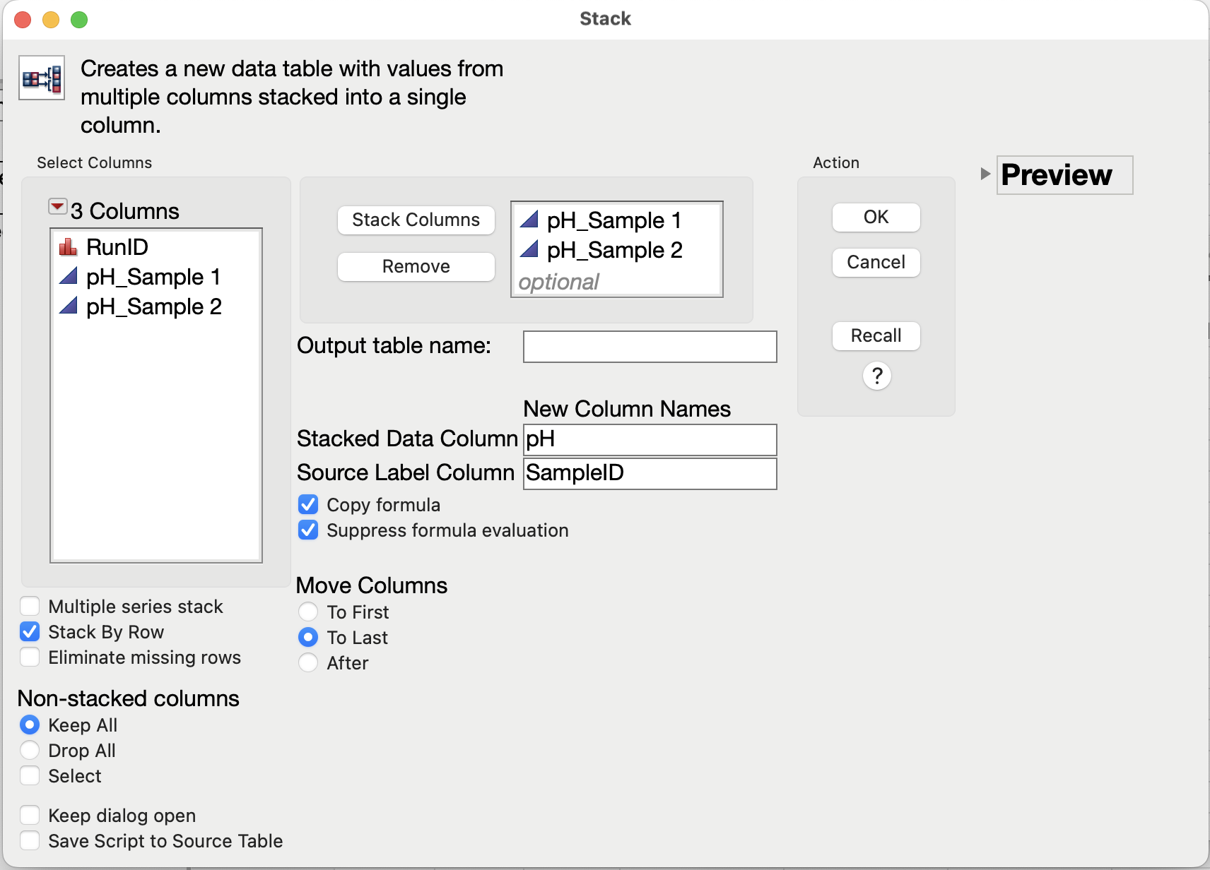
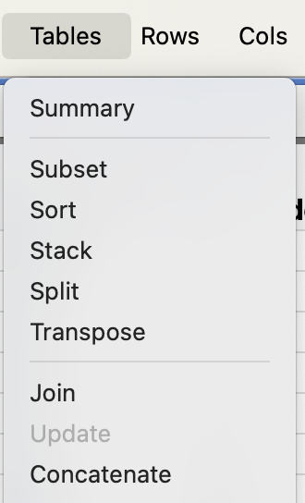
Exercise: JMP Tables Menu
The folder JMP_Tables_Menu contains exercises for Tables menu items – see JMP_Tables_Menu_Exercises.pdf
Each menu command has sample data to use for exploring how the menu option works

Slide 18
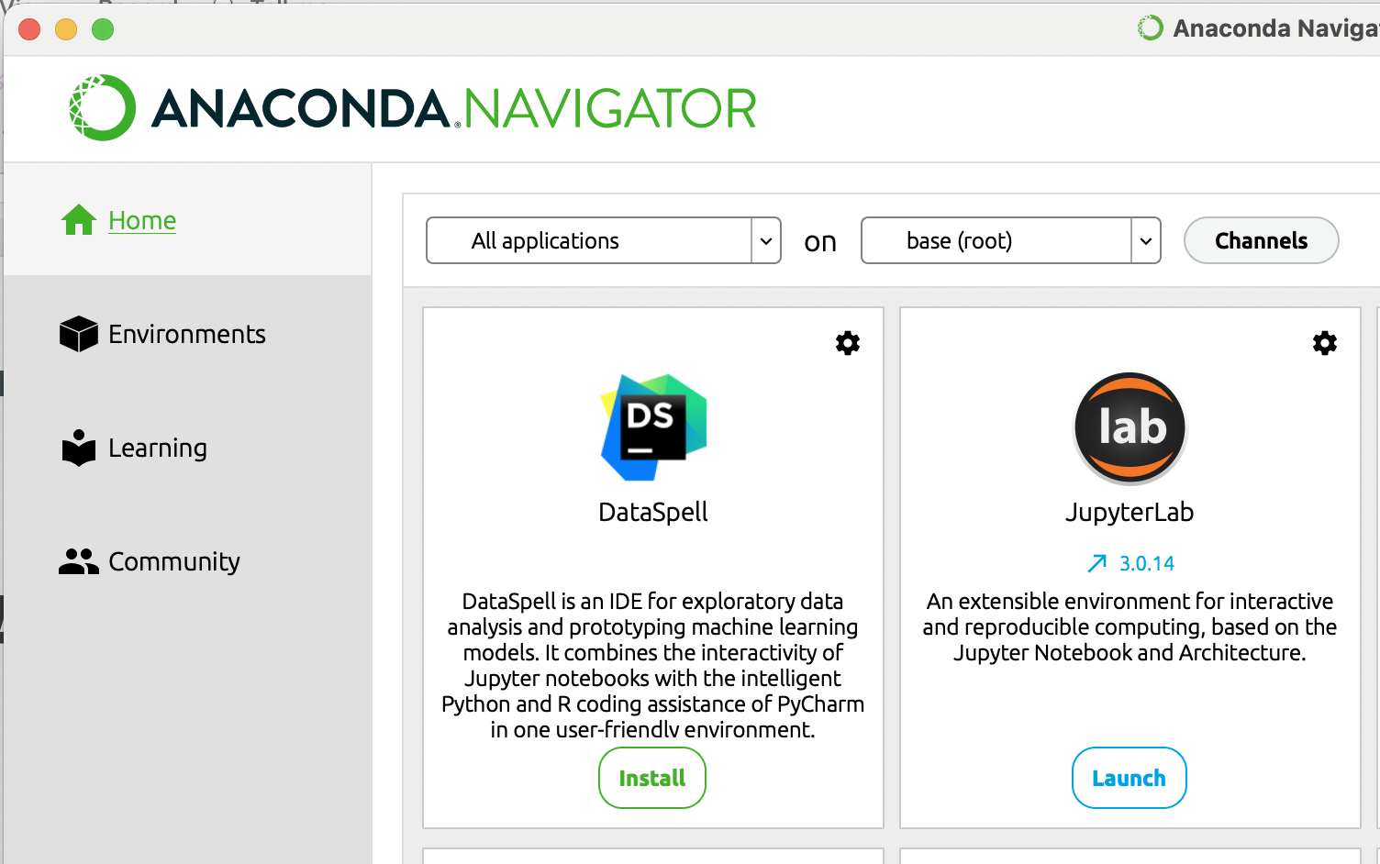
Anaconda and JupyterLab
The “Anaconda Distribution” from Anaconda.org is a good way to get Python and useful Python libraries
It installs the Anaconda-Navigator app on your computer
Can also use command line to launch Python tools
Anaconda-Navigator
Home tab has tile for launching JupyterLab
Environments tab lists and maintains installed libraries

Slide 19
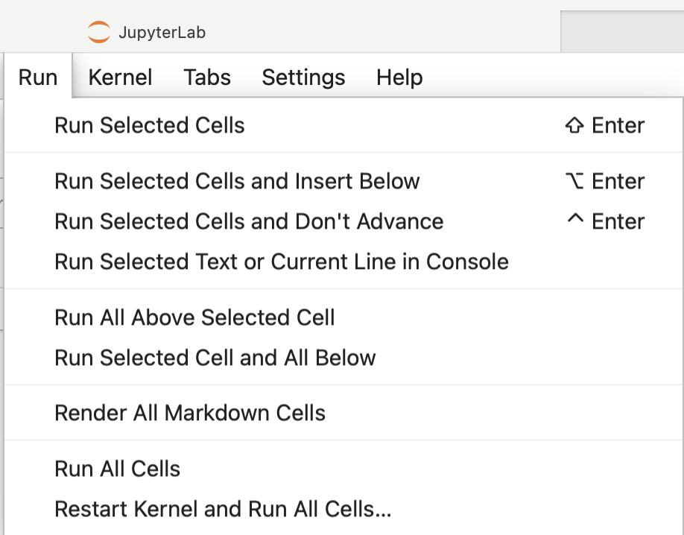

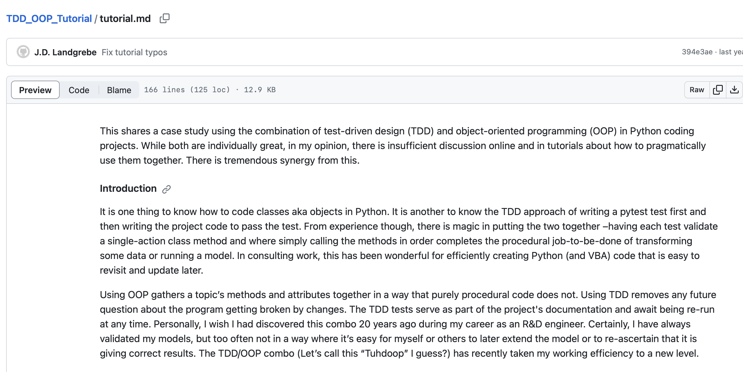
Jupyter Notebooks and Best Practices
(This slide is a placeholder for a longer-term journey being comfortable with using Python tools routinely!)
Notebooks use *.ipynb file extension
Notebook cells can be Code or markdown text
Launches in browser but not internet-connected
Has its own menus
Shift-Enter to run current cell
Run menu / Run All Cells to run all from start to end
Kernel / Restart Kernel to reset variable values
Watchout: Running cells out of order can create unexpected results or errors!
Exercise:
Write a function in Jupyter notebook
Move the function to a separate *.py file and run from there
A robust development process involves a “Tuhdoop” approach with *.py files and testing.
Tuhdoop = TDD/OOP = Test Driven Development + Object Oriented Programming
See tutorial.md at https://github.com/jlandgre/TDD_OOP_Tutorial

Slide 20





Python Libraries to Extend Functionality
Useful Python libraries for Engineers and Scientists
You can get these with Anaconda installation!!
Pandas – Data reshaping and analysis
Numpy – Numerical calculations
Pytest – Test/Validate your scripts
OpenPyXL – Format outputs in Excel
Re (Regular Expressions aka Regex) – Parse text strings

Slide 21
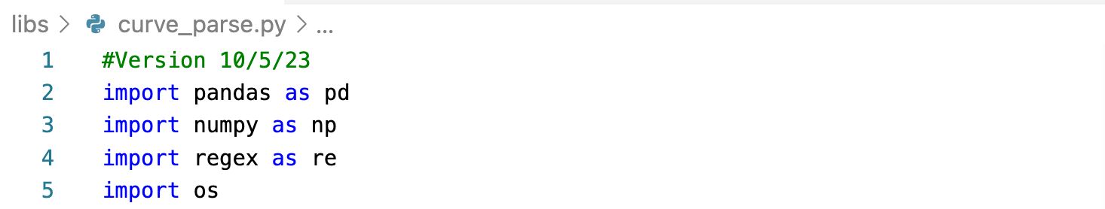
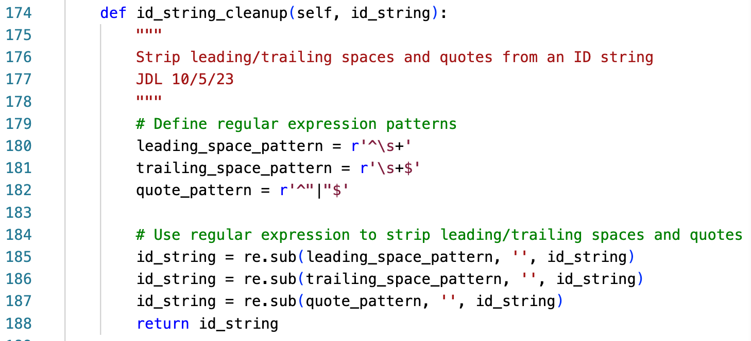
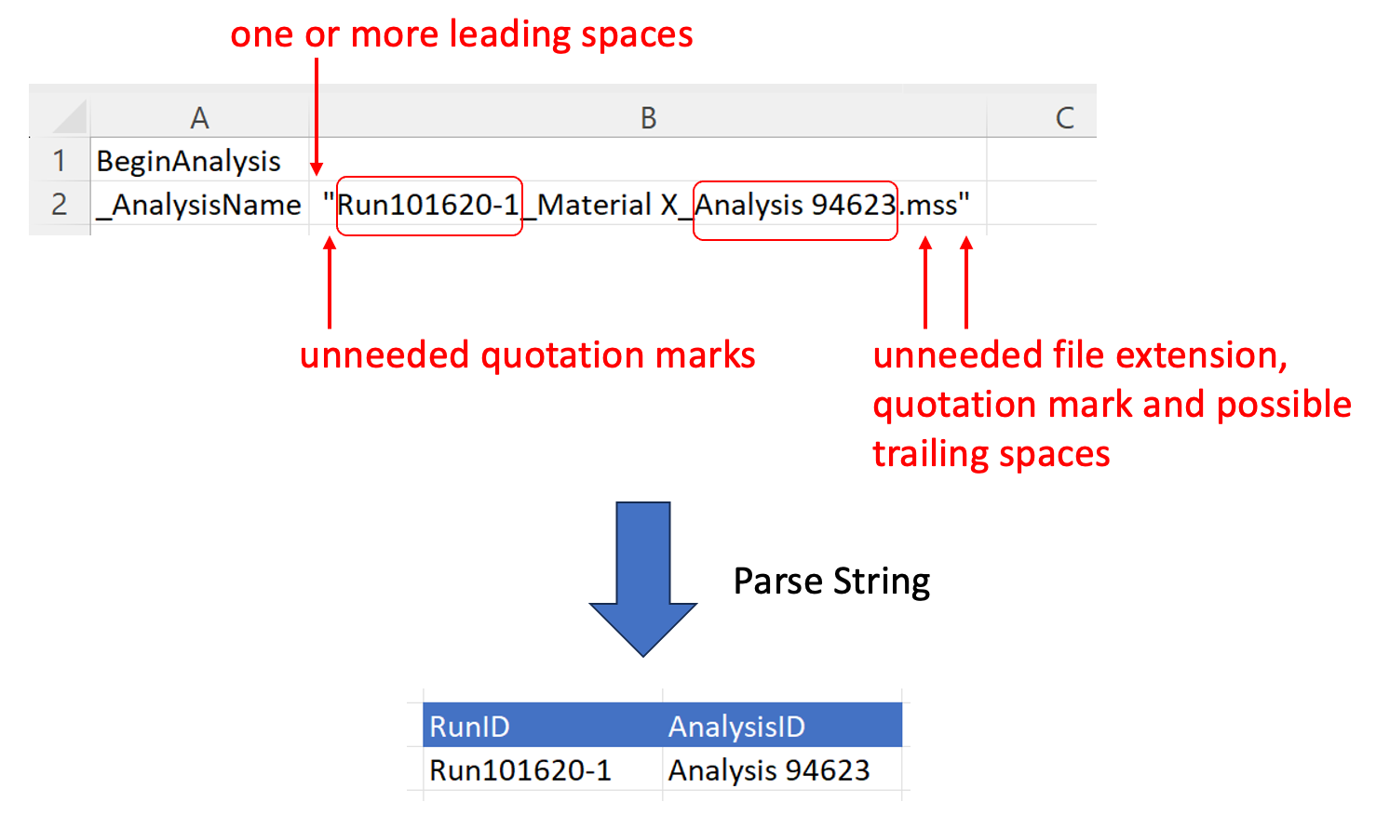
Example: Python Regex Package to Extract Strings
Lab instrument software outputs IDs in string needing cleanup
regex Python package can strip out unneeded quotation marks, spaces and (not shown) file extension
(Not shown) Either regex or Python split() command can break the string into pieces using underscore characters as delimiters
Regex code for ”zero or more spaces at beginning of string”
(“ChatGPT pls help!!”)

Slide 22
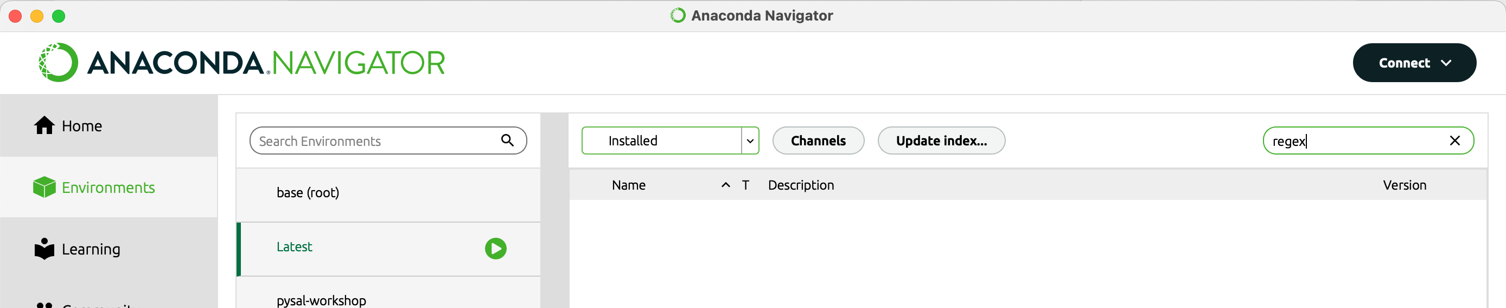
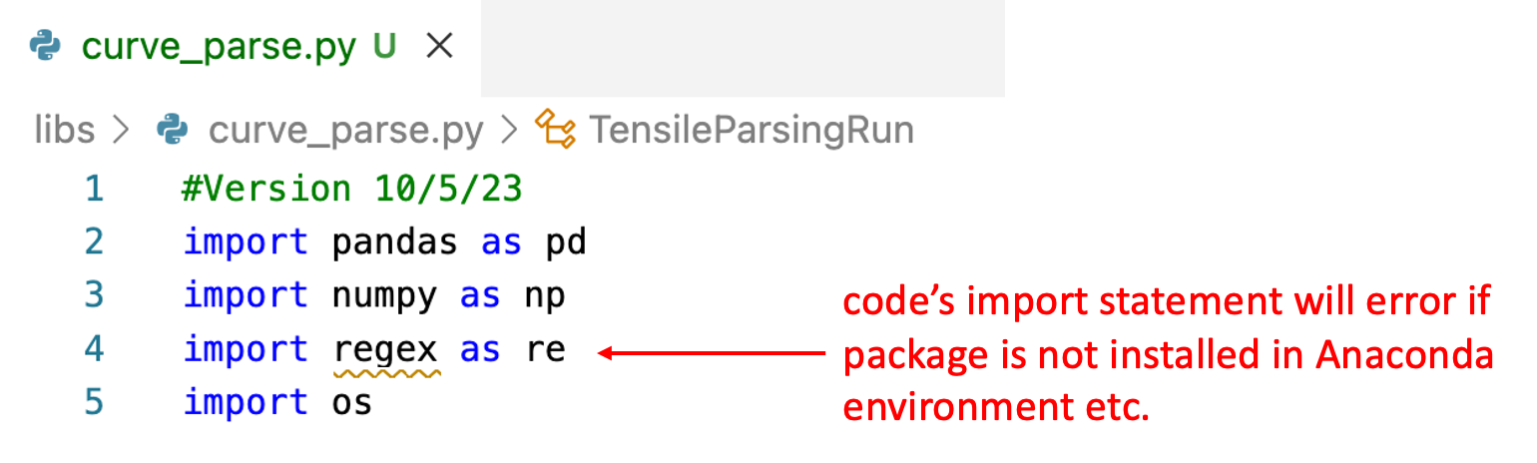
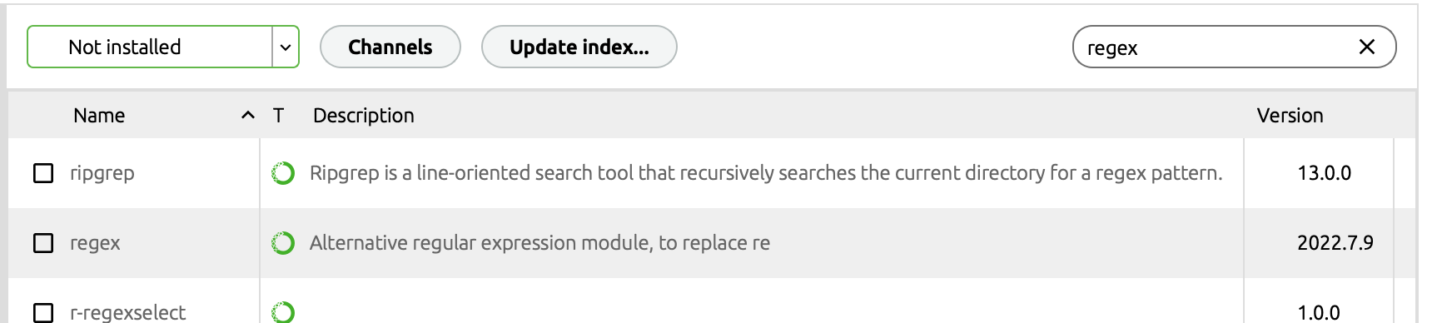
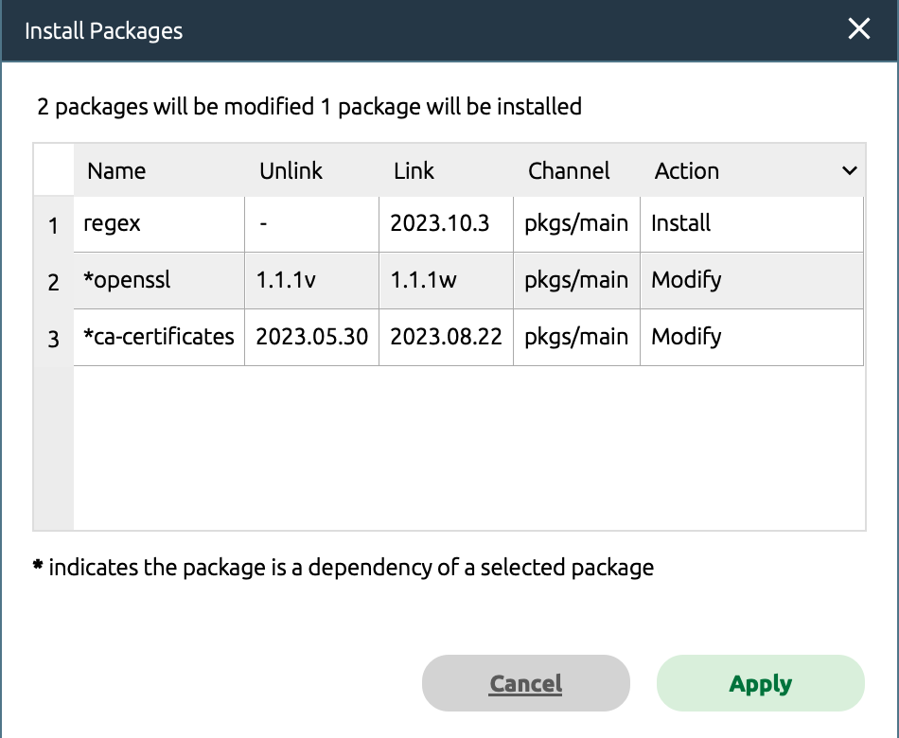
Installing Packages (AKA Libraries) In Anaconda
1
1a
=
** regex is not Installed in environment named “Latest” **
2
3
Anaconda selects related (aka “dependent”) packages needed by the selected package

Slide 23
Exercise with Using Python + PandaS
Exercise:
Clone: https://github.com/jlandgre/Pandas_Intro_For_Noncoders
Open Pandas_Fundamentals.ipynb and clear the outputs (Kernel / Restart Kernel and Clear All Outputs)
Run the cells one at a time by clicking in the first one and hitting Shift+Enter
Look up documentation for a Pandas method such as read_excel or set_index

Slide 24
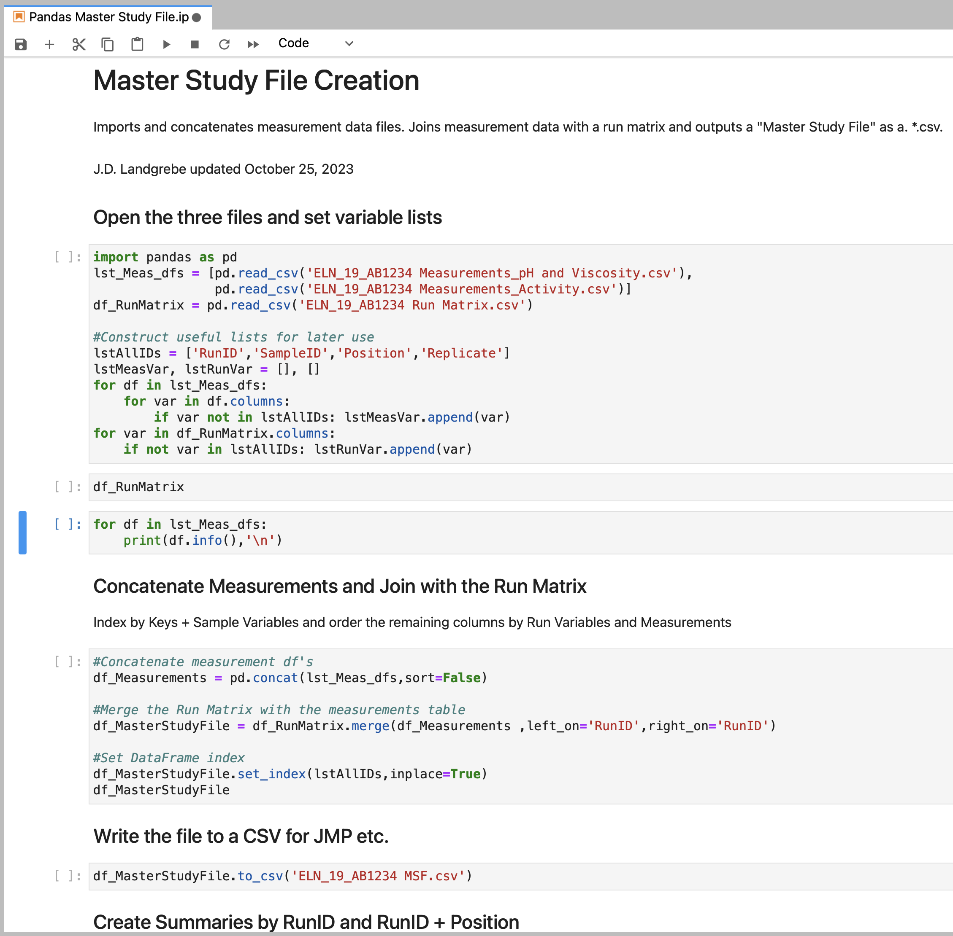
Aggregating Data (PAnDAS)
See Jupyter Notebook:
Pandas Master Study File Demo.ipynb
This performs the same concatenate and join transformations as the previous JMP example

Slide 25
Parsing Raw Data
“Parsing” refers to going from a repeatable non-structured format to structured rows/columns
Parsing needs to identify samples by its RunID, SampleID (e.g. sampling time/location) and AnalysisID metadata for the result to be considered “structured” (e.g. each sample’s data uniquely identified and traceable back to its source)
Study owner needs to pre-plan/intervene with lab to ensure metadata are available/parseable post-measurement!!!
Parsing requirements vary [wildly!] depending on data source
Manually-entered data are a special case because humans are very creative about how they choose to enter data
Lab instruments typically have specialized software that outputs raw and/or parameterized data
Parsing example: tensile tester data https://github.com/jlandgre/Python_Curve_Parser

Slide 26
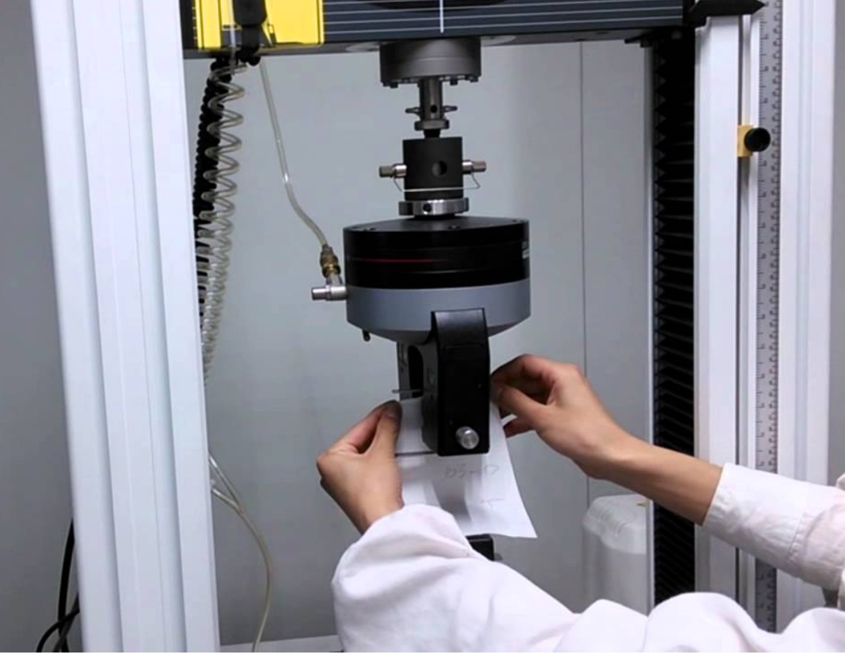

Raw Data Parsing Example Data From MTS Tensile Tester Software
Testing involves pulling apart substrate(s) such as hook and loop fastener or adhesive-coated strip + landing surface
Measurement of force versus displacement while separating the materials –peak load and average load are key results
Requires multiple samples to get good data: Testing is noisy due to sample prep of joining substrates and general noise from failure testing

Slide 27
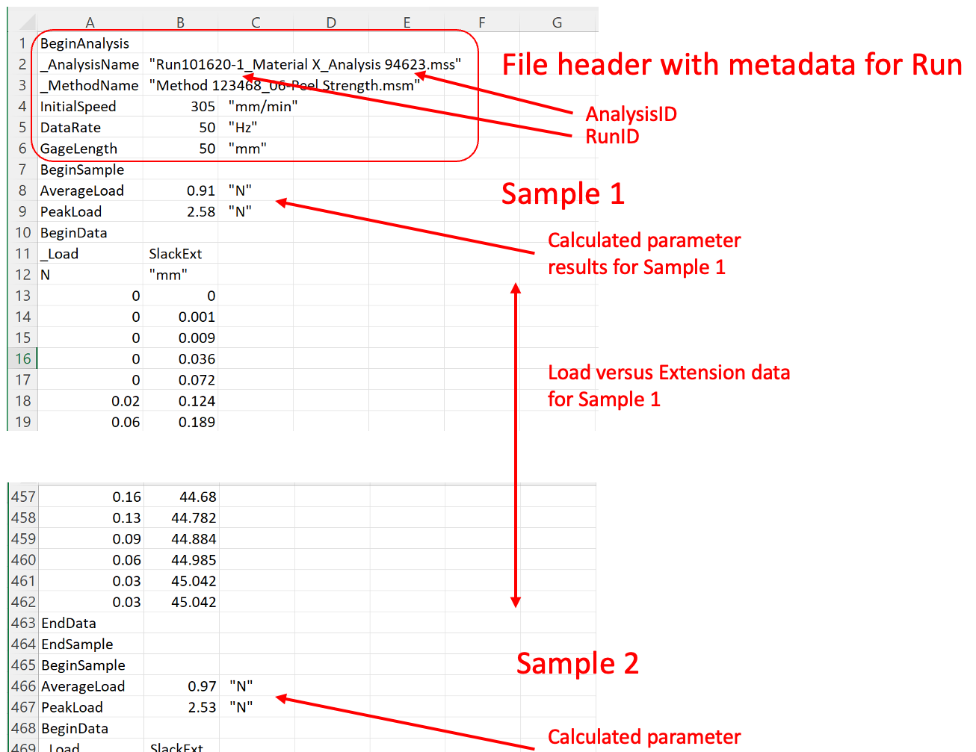
Raw Data Parsing Example Data From MTS Tensile Tester Software
Instrument software outputs files containing data for multiple samples from a run
Raw files contain a combination of calculated parameters and raw data –we want to analyze both!!

Slide 28
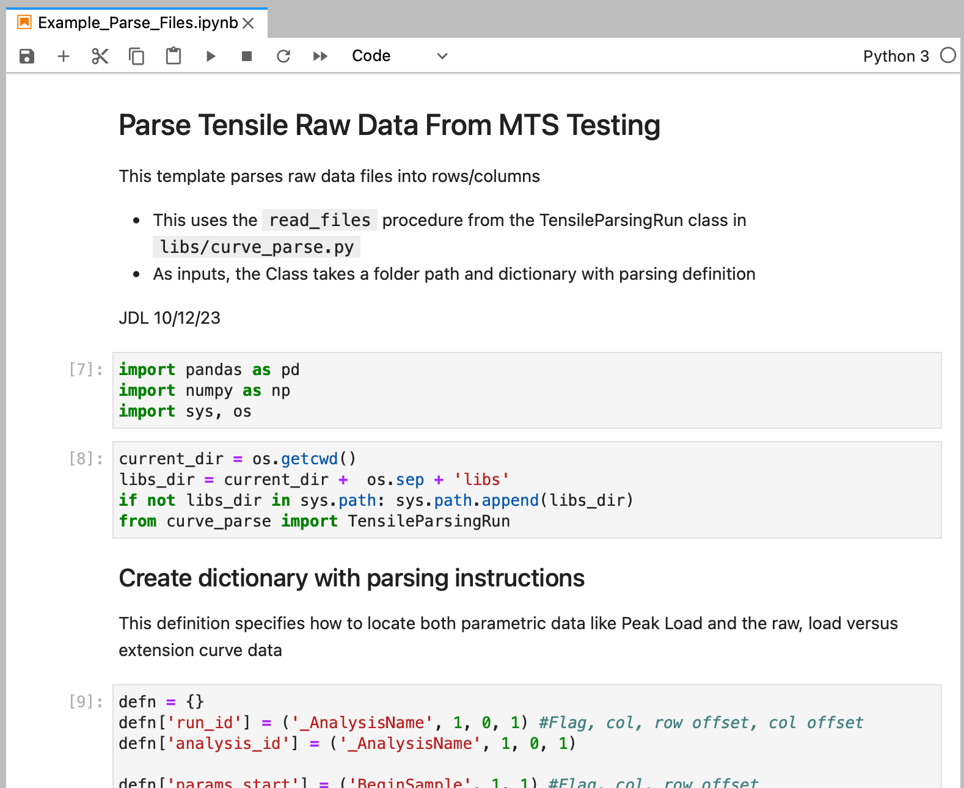
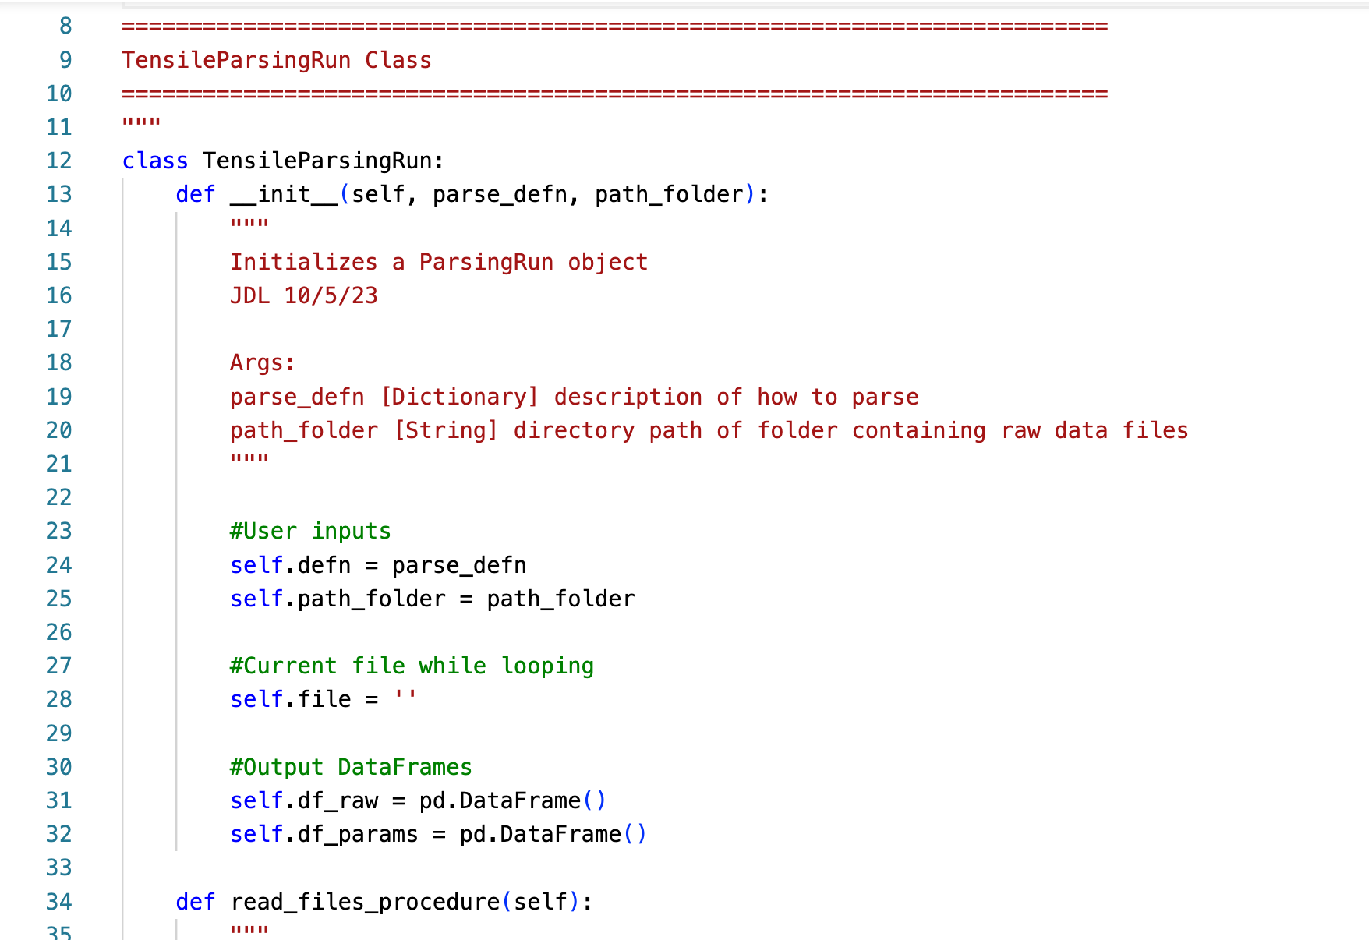
Custom Python Parser for Tensile Data
To try it with example data, clone from: https://github.com/jlandgre/Python_Curve_Parser
Parser consists of a Python Class in curve_parse.py (run with example data from Example_Parse_Files.ipynb)
Creates output files: df_params.xlsx and df_raw.xlsx

Slide 29
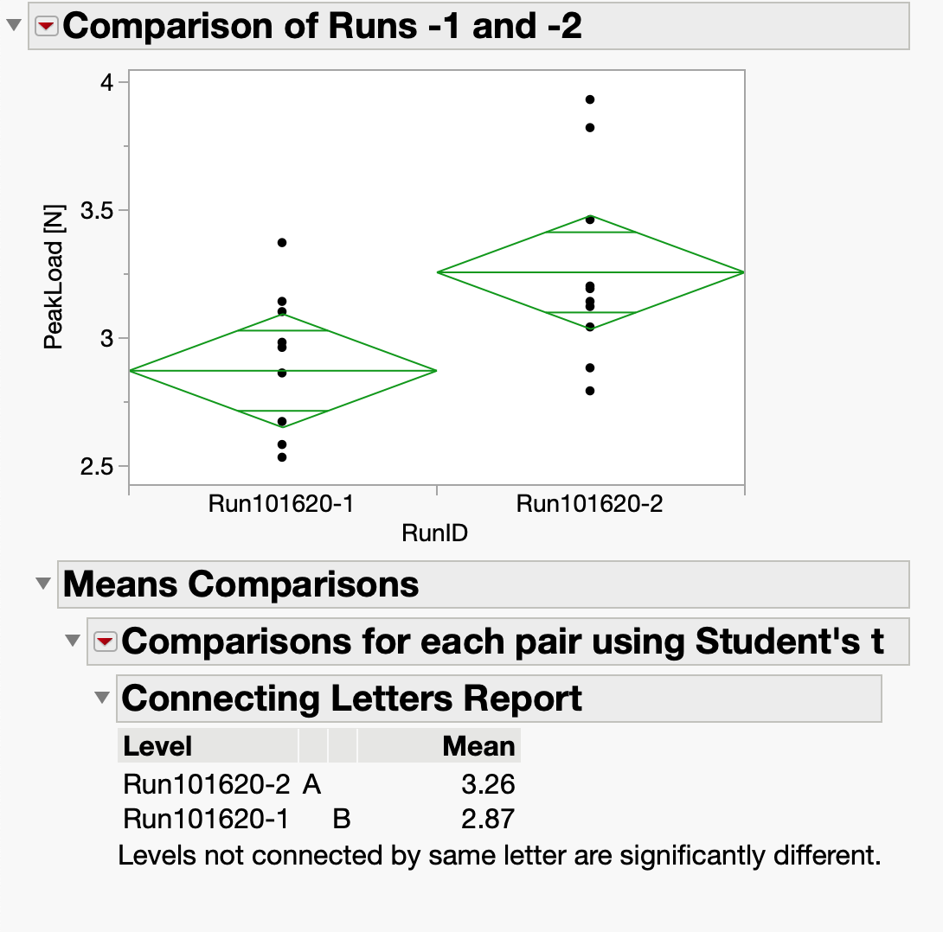
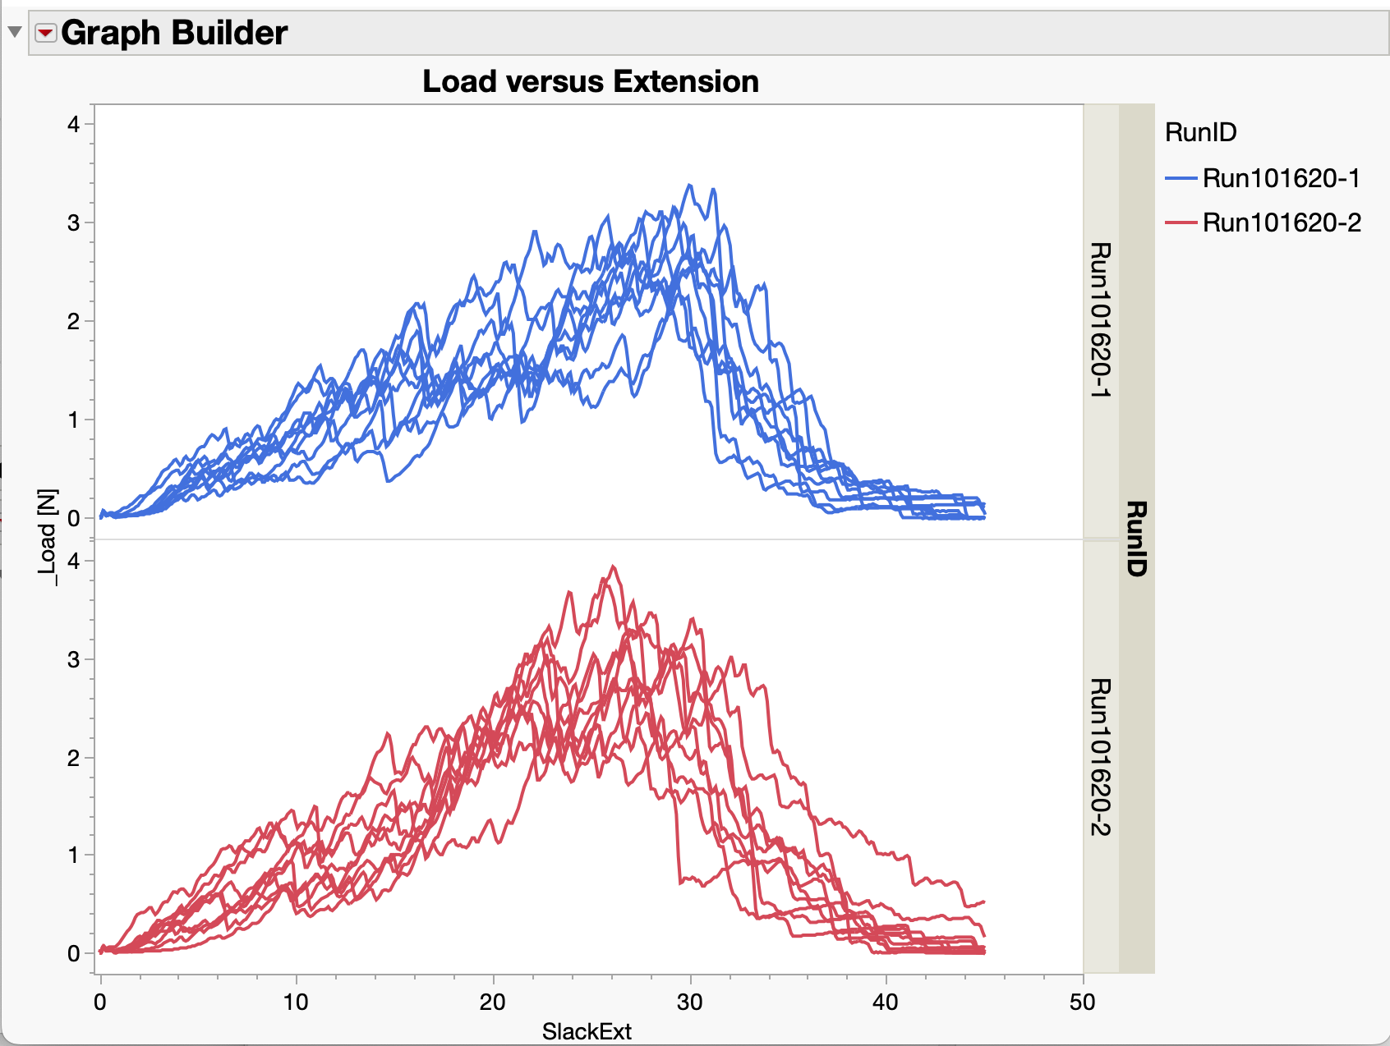
JMP Analysis of Parsed Data
The whole point of the parser is to gain ability to visualize and study the data –without expending lots of “copy/paste” effort
JMP Demo on quick analysis of parsed data
Analyze menu / Fit Y by X:
Run101620-2 has significantly higher Peak Load than -1 (p<0.05)
Standard deviations (spread of peak load data) look similar
Graphs of Load versus extension curves
Run -1 has [qualitatively] more consistent slope
Several -2 samples undergo rapid force increase at 20+ mm extension

Slide 30
JMP Case Study/In-Class Assignment – Solid Cooling
See files in Canvas Assignment
Files also posted at https://github.com/jlandgre/JMP_Regression_Training (Consumer_Solid_Cooling folder)

Slide 31
Conclusion: Working with Software and Experiment Data
Software recos give you a toolbox for working with a broad range of engineering data
JMP® and Python Pandas are important tools to always have around for working with data
The Study Folder approach curates experiments to make them efficiently extensible and shareable
The standard architecture and templates for experiments give you a reusable cookbook for designing experiments and working with the resulting data
JMP gives you access to statistical analysis combined with visualizing data and building quantitative models

